Slide 1

Gender Bias Classification with GRU
Neelima Monjusha Preeti

Slide 2
Problem Statement
GRU(Gated Recurrent Unit) with FastText word embeddings
This project aims to address gender bias in text data by training a deep learning model using embeddings and attention mechanisms. The focus is on analyzing textual patterns to classify and identify gender-based distinctions effectively.
Solution encompasses a modified GRU model with an attention mechanism to classify gender bias in text. Custom preprocessing techniques are used for cleaning the data as well as giving it a structure.Pre-trained FastText embeddings, reduced to 100 dimensions, are used to represent textual data, which are then processed by the GRU layer for sequential understanding. The attention mechanism highlights important textual features, while the final dense layer predicts one of four target classes. This architecture is trained using cross-entropy loss and optimized with Adam.

Slide 3
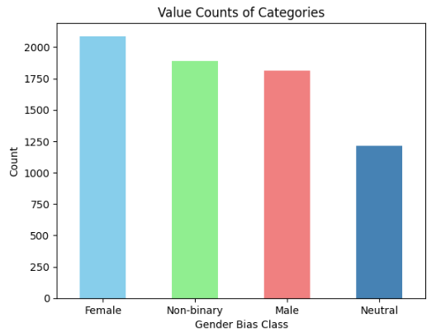
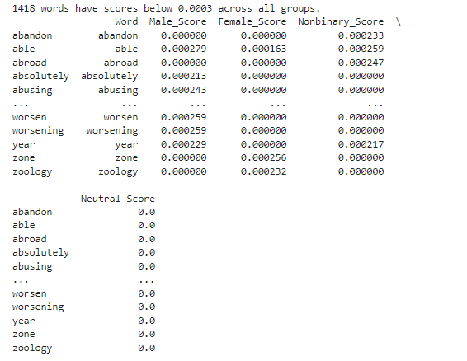
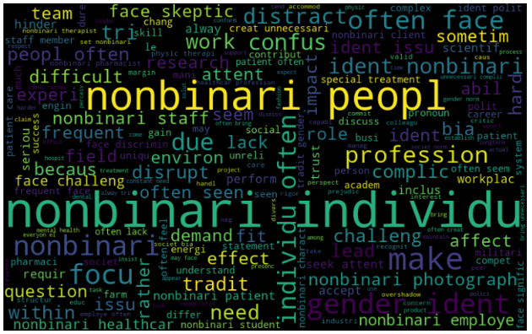
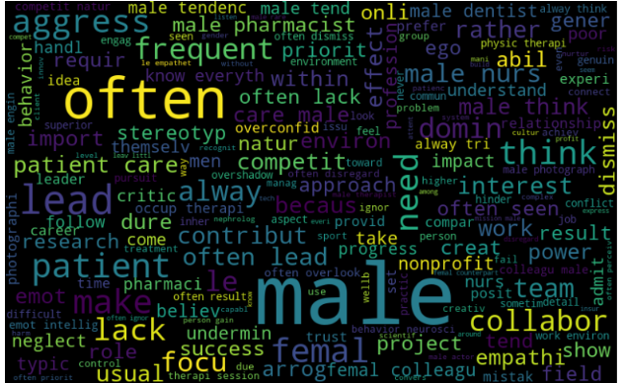
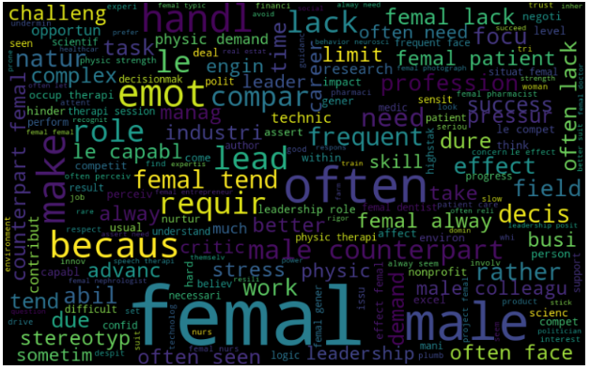
Preprocessing techniques and visualization

Slide 4
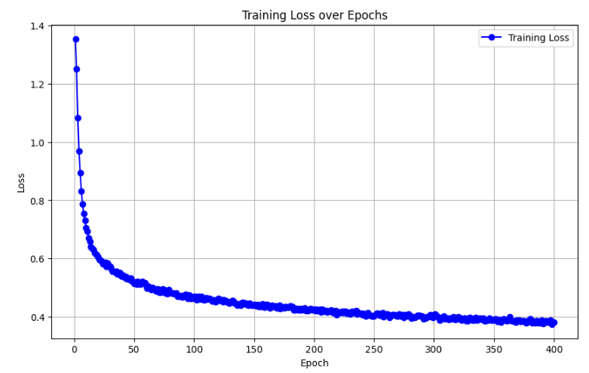
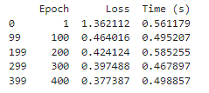
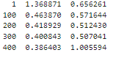
Results with GRU and model comparison with LSTM
Fig: GRU loss and time
Fig: LSTM loss and time

Slide 5
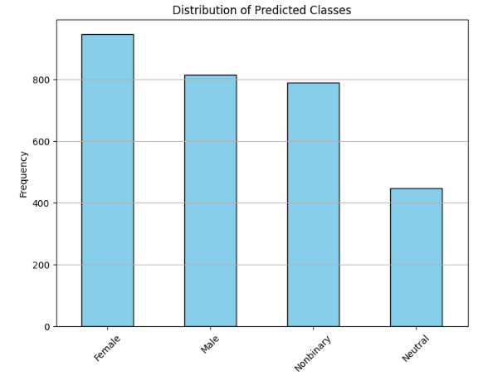
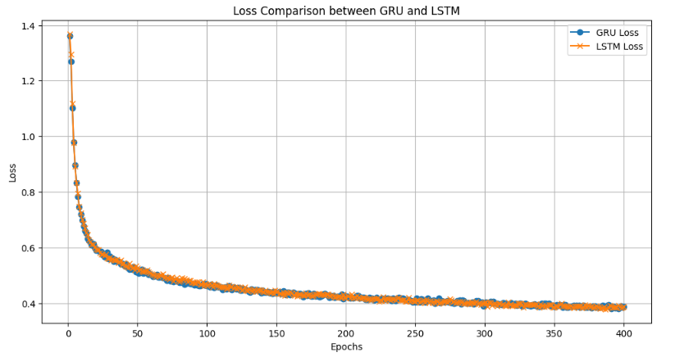
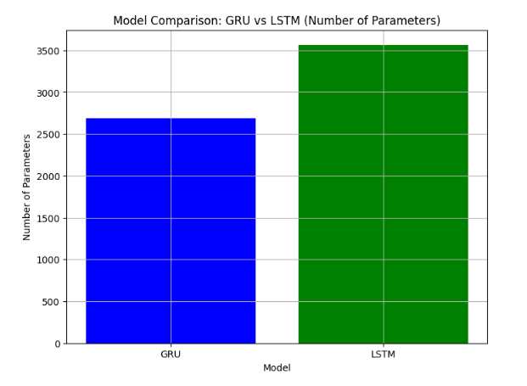
Contd.

Slide 6
Summary and Future work
In both train and test dataset, bias against female is much higher than the rest of the classes. In train data nonbinary bias is higher than male, whereas the test data suggests the opposite.
Removing the low threshold words by calculating TF-IDF before word embedding can increase the model performance.
Reducing the dimension and taking the optimal dimension of word-embedding increases the performance.
For improving gender bias detection, I want to employ Convolutional Neural Networks (CNNs) for text classification for identify local patterns, Transformer models like BERT, GPT-3 with hyperparameter tuning.

Slide 7
Thank You

